Slide 1
Session 22:
GUI (Graphical User Interface)
Dr. Naveen Kumar
Associate Professor
Amity Institute of Information Technology
Amity University Patna

Slide 2
Java.awt is a package provides environment to develop graphical user interface applications.
AWT means (Abstract Window Toolkit). AWT is used to prepare the components but it is not providing any life to that components means by using AWT it is possible to create a static components.
To provide the life to the static components we need some other package is called java.awt.event package.
By using AWT we are preparing application these applications are called console based or CUI application.
Java.awt package is used to prepare static components.
Java.awt.event package is used to provide the life to the static components.

Slide 3
GUI(graphical user interface):-
1. It is a mediator between end user and the program.
2. AWT is a package it will provide predefined support to design GUI applications.
Component : - Component is an object which is displayed pictorially on the screen.
Ex:- Button, Label, TextField......etc
Container:- Container is a GUI component, it is able to accommodate all other GUI components.
Ex:- Frame, Applet.
Event:- The event is action generated on the component or the change is made on the state of the object.
Ex:- Button clicked, Checkboxchecked, Itemselected in the list, Scrollbar scrolled horizontal/vertically.

Slide 4
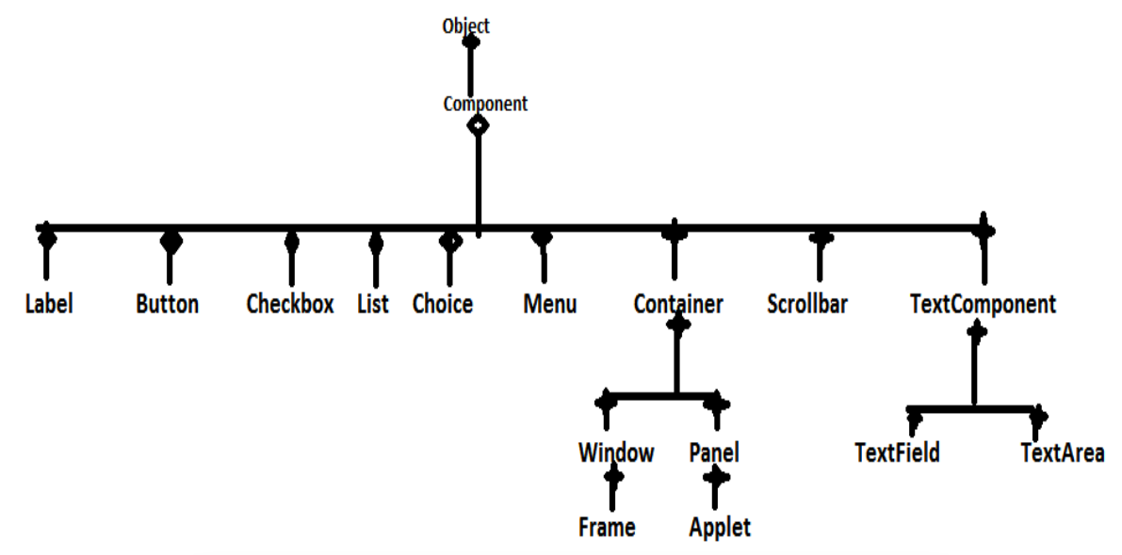
Classes of AWT
Classes of AWT:- The classes present in the AWT package.

Slide 5
Frame Class
Frame is a class which is present in java.awt package.
Frame is a Basic component in AWT, because all the components displayed in a Frame.
We are displaying pictures on the Frame.
It is possible to display some text on the Frame. Based on the above reasons the frame will become basic component in AWT.

Slide 6
Constructors
create a Frame class object.
Frame f=new Frame();
create a Frame class object and pass frame title
Frame f=new Frame("MyFrame");
Take a subclass to the Frame and create object to the subclass.
class MyFrame extends Frame
MyFrame f=new MyFrame();

Slide 7
Characteristics of the Frame
When we create a Frame class object the Frame will be created automatically with the invisible mode.
To provide visible mode to following method.
public void setVisible(boolean b)
where b==true means visible mode.
where b==false means invisible mode.
Ex: f.setVisible(true);
When we created a Frame, the initial size of the Frame is : 0 pixel height 0 pixel width So it is not visible to use.
To provide particular size to the Frame we have to use following method.
public void setSize(int width,int height)
Ex: f.setSize(400,500); 3)

Slide 8
To provide title to the Frame explicitly we have to use the following method
public void setTitle(String Title)
Ex: f.setTitle("MyFrame");
When we create a Frame, the default background color of the Frame is white.
If you want to provide particular color to the Frame we have to use the following method.
public void setBackground(color c)
Ex: f.setBackground(Color.red);

Slide 9
CREATION OF FRMAE
import java.awt.*;
class Demo
{
public static void main(String[] args)
{
//frame creation
Frame f=new Frame();
//set visibility
f.setVisible(true);
//set the size of the frame
f.setSize(400,400);
//set the background
f.setBackground(Color.red);
//set the title of the frame
f.setTitle("myframe");
}
}

Slide 10
CRATION OF FRAME BY TAKING USER DEFINED CLASS
import java.awt.*;
class MyFrame extends Frame
{
MyFrame()
{
setVisible(true);
setSize(500,500);
setTitle("myframe");
setBackground(Color.red);
}
}
class Demo
{
public static void main(String[] args)
{
MyFrame f=new MyFrame();
}
}

Slide 11
display text on the screen
1. If you want to display some textual message or some graphical shapes on the Frame then we have to override paint(), which is present in the Frame class.
public void paint(Graphics g)
2. To set a particular font to the text, we have to use Font class present in java.awt package
Font f=new Font(String type,int style,int size);
Ex: Font f= new Font("arial",Font.Bold,30);

Slide 12
import java.awt.*;
class Test extends Frame
{
public static void main(String[] args)
{
Test t=new Test();
t.setVisible(true);
t.setSize(500,500);
t.setTitle(”Strudent Registration");
t.setBackground(Color.red);
}
public void paint(Graphics g)
{
Font f=new Font("arial",Font.ITALIC,25);
g.setFont(f);
g.drawString("hi Welcome to Amity University, how r u",100,100);
}
}

Slide 13
Note:- 1. When we create a MyFrame class constructor, jvm executes MyFrame class construcor just before this JVM has to execute Frame class zero argument constructor.
2. In Frame class zero argument constructor repaint() method will be executed, it will access predefined Frame class paint() method.
But as per the requirement overriding paint() method will be executed.
3. Therefore the paint() will be executed automatically at the time of Frame creation.

Slide 14
Preparation of the components
Label: - 1) Label is a constant text which is displayed along with a TextField or TextArea.
2) Label is a class which is present in java.awt package.
3) To display the label we have to add that label into the frame for that purpose we have to use add() method present in the Frame class.
Constructor:-
Label l=new Label();
Label l=new Label(“user name”);

Slide 15
import java.awt.*;
class Test
{
public static void main(String[] args)
{
Frame f=new Frame();
f.setVisible(true);
f.setTitle(”AIIT – Amity University");
f.setBackground(Color.red);
f.setSize(400,500);
Label l=new Label("user name:");
f.add(l);
}
}

Slide 16
TextField
1) TextField is an editable area.
2) In TextField we are able to provide single line of text.
3) Enter Button doesn’t work on TextField.
To add TextField into the Frame we have to use add() method.
1. To set Text to the textarea we have to use the following method.
t.setText(“AIIT (Amity Institute of Information Technology”);
2. To get the text form the TextArea we have to use fallowing method.
String s=t.getText();
3. To append the text into the TextArea.
t.appendText("ratan");
Constructor:- TextFiled tx=new TextFiled();
TextField tx=new TextField(“ratan”);

Slide 17
import java.awt.*;
class Test
{
public static void main(String[] args)
{
Frame f=new Frame();
f.setVisible(true);
f.setTitle(”Name: ");
f.setBackground(Color.red);
f.setSize(400,500);
//TextField tx=new TextField(); empty TextField
TextField tx=new TextField(”Dr. Naveen Kumar");
//TextField with data
f.add(tx);
}
}

Slide 18
TextArea
1) TextArea is a class present in java.awt.package.
2) TextArea is a Editable Area. Enter button will work on TextArea.
3) To add the TextArea into the frame we have to use the add()
Construction:- TextArea t=new TextArea();
TextArea t=new TextArea(int rows, int columns);
4. To set Text to the textarea we have to use the following method.
t.setText(“Amity University”);
5. To get the text form the TextArea we have to use fallowing method. String s=t.getText();
6. To append the text into the t.appendText(”AIIT");

Slide 19
import java.awt.*;
class Test
{
public static void main(String[] args)
{
Frame f=new Frame();
f.setVisible(true);
f.setTitle(”AIIT");
f.setBackground(Color.red);
f.setSize(400,500);
f.setLayout(new FlowLayout());
Label l=new Label("user name:");
TextArea tx=new TextArea(4,10);//4 character height 10 character width
tx.appendText(”AIIT");
tx.setText(”BCA/MCA");
System.out.println(tx.getText());
f.add(l);
f.add(tx);
}
}

Slide 20
Choice
1) Choice is a class present in java.awt package.
2) List is allows to select multiple items but choice is allow to select single Item.
Constructor:- Choice ch=new Choice(); Methods :-
1. To add items to the choice we have to use following method.
ch.add(“HYD”);
ch.add(“Chennai”);
ch.add(“BANGALORE”);
2. To remove item from the choice based on the string.
ch.remove(“HYD”);
ch.remove(“BANGALORE”);

Slide 21
3. To remove the item based on the index position ch.remove(2);
4. To remove the all elements ch.removeAll();
5. To inset the data into the choice based on the particular position. ch.insert(2,”ratan”);
6. To get selected item from the choice we have to use following method.
String s=ch.getSelectedItem();
7. To get the selected item index number we have to use fallowing method
int a=ch.getSelectedIndex();

Slide 22
import java.awt.*;
class Test
{
public static void main(String[] args)
{
Frame f=new Frame();
f.setVisible(true);
f.setTitle(”Amity University");
f.setBackground(Color.red);
f.setSize(400,500);
Choice ch=new Choice();
ch.add("c");
ch.add("cpp");
ch.add("java");
ch.add(".net");
ch.remove(".net");
ch.remove(0);
ch.insert(”Adv. Java",0);
f.add(ch);
System.out.println(ch.getItem(0));
System.out.println(ch.getSelectedItem());
System.out.println(ch.getSelectedIndex());
//ch.removeAll();
}
}

Slide 23
List
1) List is a class it is present in java.awt.package
2) List is providing list of options to select. Based on your requirement we can select any number of elements. To add the List to the frame we have to use add() method.
CONSTRUCTOR:-
1) List l=new List();
It will creates the list by default size is four elements. And it is allow selecting the only one item at a time.
2) List l=new List(3); It will display the three items size and it is allow selecting the only single item.
3) List l=new List(5,true); It will display the five items and it is allow selecting the multiple items.

Slide 24
Methods:- 1. To add the elements to the List we have to use following method.
l.add(“c”);
l.add(“cpp”);
l.add(“java”);
l.add(“ratan”,0);
2. To remove element from the List we have to use following method.
l.remove(“c”);
l.remove(2);
3. To get selected item from the List we have to use following method. String x=l.get SelectedItem();
4. To get selected items from the List we have to use following method. String[] x=s.get SelectedItems()

Slide 25
import java.awt.*;
class Test
{
public static void main(String[] args)
{
Frame f=new Frame();
f.setVisible(true);
f.setTitle(”Amity University");
f.setBackground(Color.red);
f.setSize(400,500);
f.setLayout(new FlowLayout());
List l=new List(4,true);
l.add("c");
l.add("cpp");
l.add("java");
l.add(".net");
l.add("ratan");
l.add("arun",0);
l.remove(0);
f.add(l);
System.out.println(l.getSelectedItem());
}
}

Slide 26
Checkbox
1) Checkbox is a class present in java.awt package.
2) The user can select more than one checkbox at a time. To add the checkbox to the frame we have to use add() method.
Constructor:-
1) Checkbox cb1=new CheckBox(); cb1.setLable(“BTECH”);
2) Checkbox cb1=new CheckBox(“MCA”);
3) Checkbox cb3=new CheckBox(“BSC”,true);

Slide 27
CheckBox Methods
To set a label to the CheckBox explicitly and to get label from the CheckBox we have to use the
following method. cb.setLabel(“BSC”);
To get the label of the checkbox we have to use fallowing method. String str=cb.getLabel();
To get state of the CheckBox and to set state to the CheckBox we have to use following method. Boolean b=ch.getState();

Slide 28
import java.awt.*;
class Test {
public static void main(String[] args) {
Frame f=new Frame();
f.setVisible(true);
f.setTitle("ratan"); f.setBackground(Color.red); f.setSize(400,500);
Checkbox cb1=new Checkbox("BTECH",true); f.add(cb1); System.out.println(cb1.getLabel());
System.out.println(cb1.getState());
}
}

Slide 29
RADIO BUTTON
1) AWT does not provide any predefined support to create RadioButtons.
2) It is possible to select Only item is selected from group of item. To add the RadioButton to the
frame we have to use add() method.
By using two classes we create Radio Button those are
a)CheckBoxgroup b)CheckBox
step 1:- Create CheckBox group object. CheckBoxGroup cg=new CheckBoxGroup();
step 2:- pass Checkbox object to the CheckboxGroup class then the radio buttons are created. CheckBox cb1=new CheckBox(“male”,cg,false);
CheckBox cb2=new CheckBox(“female”,cg,false);

Slide 30
Methods:-
1) To set status and to get status we have to use setState() and getState() methods.
String str=Cb.getState();
Cb.setState();
2) To get Label and to set Label we have to use following methods.
String str=getLabel() setLabel(“female”).

Slide 31
import java.awt.*;
class Test
{
public static void main(String[] args) {
Frame f=new Frame();
f.setVisible(true);
f.setTitle("ratan");
f.setBackground(Color.red);
f.setSize(400,500);
CheckboxGroup cg=new CheckboxGroup();
Checkbox cb1=new Checkbox("male",cg,true);
f.add(cb1);
System.out.println(cb1.getLabel());
System.out.println(cb1.getState());
}

Slide 32
Layout Managers
import java.awt.*;
class Test {
public static void main(String[] args) {
Frame f=new Frame();
f.setVisible(true);
f.setTitle("ratan");
f.setBackground(Color.red);
f.setSize(400,500);
Label l1=new Label("user name:");
TextField tx1=new TextField();
Label l2=new Label("password:");
TextField tx2=new TextField();
Button b=new Button("login");
f.add(l1);
f.add(tx1);
f.add(l2);
f.add(tx1);
f.add(b);
}
}

Slide 33
Event delegation model
When we create a component the components visible on the screen but it is not possible to perform any action for example button.
Whenever we create a Frame it can be minimized and maximized and resized but it is not possible to close the Frame even if we click on Frame close Button.
The Frame is a static component so it is not possible to perform actions on the Frame.
To make static component into dynamic component we have to add some actions to the Frame.
To attach actions to the Frame component we need event delegation model.
Note: Whenever we click on button no action will be performed clicking like this is called event.

Slide 34
Event
Event is nothing but a particular action generated on the particular component.
When an event generates on the component the component is unable to respond because component can't listen the event.
To make the component listen the event we have to add listeners to the component.
Wherever we are adding listeners to the component the component is able to respond based on the generated event.
A listener is an interface which contain abstract methods and it is present in java.awt.event package
The listeners are different from component to component.
A component delegate event to the listener and listener is designates the event to appropriate method by executing that method only the event is handled. This is called Event Delegation Model.

Slide 35
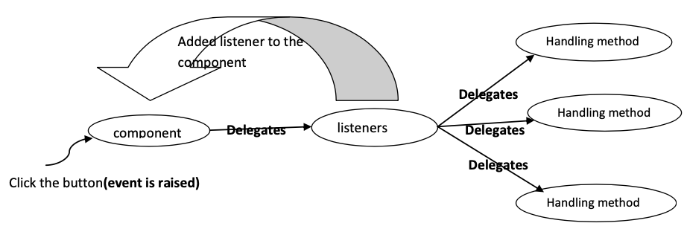

Slide 36
Note: - To attach a particular listener to the Frame we have to use following method
Public void AddxxxListener(xxxListener e) Where xxx may be ActionListener, windowListener The Appropriate Listener for the Frame is “windowListener”

Slide 37
class MyFrame extends Frame implements ActionListener {
TextField tx1,tx2,tx3;
Label l1,l2,l3;
Button b1,b2;
int result;
MyFrame() {
this.setSize(250,400);
this.setVisible(true);
this.setLayout(new FlowLayout());
l1=new Label("first value");
l2=new Label("second value");
l3=new Label("result");
tx1=new TextField(25);
tx2=new TextField(25);
tx3=new TextField(25);
b1=new Button("add");
b2=new Button("mul");
b1.addActionListener(this);
b2.addActionListener(this);
this.add(l1);
this.add(tx1);
this.add(l2);
this.add(tx2);
this.add(l3);
this.add(tx3);
this.add(b1);
this.add(b2);
}
}

Slide 38
public void actionPerformed(ActionEvent e) {
try{
int fval=Integer.parseInt(tx1.getText());
int sval=Integer.parseInt(tx2.getText());
String label=e.getActionCommand();
if (label.equals("add")) {
result=fval+sval;
}
if (label.equals("mul")) {
result=fval*sval;
} tx3.setText(""+result); }
catch(Exception ee) {
ee.printStackTrace();
} }
}
class Demo {
public static void main(String[] args) {
MyFrame f=new MyFrame();
} }

Slide 39
ScrollBar
1. ScrollBar is a class present in the java.qwt.package 2. By using ScrollBar we can move the Frame up and down.
ScrollBar s=new ScrollBar(int type)
Type of scrollbar
VERTICAL ScrollBar
HORIZONTAL ScrollBar
To create a HORIZONTAL ScrollBar:- ScrollBar sb=new ScrollBar(ScrollBar.HORIZONTAL); To get the current position of the scrollbar we have to use the following method. public int getValue()
To create a VERTICAL ScrollBar:- ScrollBar sb=new ScrollBar(ScrollBar.VERTICAL);

Slide 40
Appropriate Listeners for Components
Component | Event Name | Listener Name | Listener Methods
Frame | Window Event | Window Listener | p v WindowOpened(WE) p v WindowActivated(WE) p v WindowDeactivated(WindowEvent e) p v WindowClosing(WindowEvent e) p v WindowClosed(WindowEvent e) p v WindowIconfield(WindowEvent e) p v WindowDeiconified(WindowEvent e)
TextField | ActionEvent | ActionListener | P v ActionPerformed(AE)
TextArea | ActionEvent | AcctionListener | P v ActionPerformed(AE)
Menu | ActionEvent | ActionListener | P v ActionPerformed(AE)
Button | ActionEvent | ActionListener | P v ActionPerformed(AE)
Checkbox | ItemEvene | ItemListener | P v ItemStatementChange(ItemEvent)
Radio | ItemEvent | ItemListener | P v ItemStatementChanged(ItemEvent)
List | ItemEvent | ItemListener | P v ItemStateChanged(ItemEvent)

Slide 41
Appropriate Listeners for Components
Component | Event Name | Listener Name | Listener Methods
Choice | ItemEvent | ItemListener | P v ItemeStatechanged(ItemEvent)
Scrollbar | AdjustmentEvent | AdjustmentListener | Pv AdjustmentValueChanged(AdjustmentEvent)
Mouse | MouseEvent | MouseListener | pv MouseEntered(MouseEvent e) pv MouseExited(MouseEvent e) pv MousePressed(MouseEvent e) pv MouseReleased(MouseEvent e) pv MouseClicked(MouseEvent e)
Keyboard | KeyEvent | KeyListener | pv KeyTyped(KeyEvent e) pv KeyPressed(KeyEvent e) pv KeyReleased(KeyEvent e)

Slide 42
PROVIDING CLOSING OPTION TO THE FRAME
import java.awt.*;
import java.awt.event.*;
class MyFrame extends Frame {
MyFrame() {
this.setSize(400,500);
this.setVisible(true);
this.setTitle("myframe");
this.addWindowListener(new MyClassImpl());
}
}

Slide 43
PROVIDING CLOSING OPTION TO THE FRAME
class MyClassImpl implements WindowListener{
public void windowActivated(WindowEvent e) {
System.out.println("window activated");
}
public void windowDeactivated(WindowEvent e) {
System.out.println("window deactivated");
}
public void windowIconified(WindowEvent e) {
System.out.println("window iconified");
}
public void windowDeiconified(WindowEvent e) {
System.out.println("window deiconified");
}
public void windowClosed(WindowEvent e) {
System.out.println("window closed");
}
public void windowClosing(WindowEvent e) {
System.exit(0);
}
public void windowOpened(WindowEvent e) {
System.out.println("window Opened");
}
}

Slide 44
PROVIDING CLOSING OPTION TO THE FRAME
class Demo{
public static void main(String[] args) {
MyFrame f=new MyFrame();
}
}

Slide 45
PROVIDING CLOSEING OPTION THE FRAME
import java.awt.*;
import java.awt.event.*;
class MyFrame extends Frame {
MyFrame() {
this.setVisible(true);
this.setSize(500,500);
this.setBackground(Color.red);
this.setTitle("rattaiah");
this.addWindowListener(new ListenerImpl());
}
}

Slide 46
class ListenerImpl extends WindowAdapter {
public void windowClosing(WindowEvent we) {
System.exit(0);
}
}
class Demo {
public static void main(String[] args) {
MyFrame f=new MyFrame();
}
}
Note :- by using WindowAdaptor class we can close the frame. Internally WindowAdaptor class implements WindowListener interface. Hence WindowAdaptor class contains empty implementation of abstract methods.

Slide 47
PROVIDING CLOSEING OPTION THE FRAME
import java.awt.*;
import java.awt.event.*;
class MyFrame extends Frame {
MyFrame() {
this.setVisible(true);
this.setSize(500,500);
this.setBackground(Color.red);
this.setTitle("rattaiah");
this.addWindowListener(new WindowAdapter() {
public void windowClosing(WindowEvent we) {
System.exit(0);
}
});
}
}
class FrameEx {
public static void main(String[] args) {
MyFrame f=new MyFrame();
}
}

Slide 48
WRITE SOME TEXT INTO THE FRAME
import java.awt.*;
class MyFrame extends Frame
{
MyFrame() {
this.setVisible(true);
this.setSize(500,500);
this.setBackground(Color.red);
this.setTitle("rattaiah");
}
public void paint(Graphics g) {
Font f=new Font("arial",Font.BOLD,20);
g.setFont(f);
this.setForeground(Color.green);
g.drawString("HI BTECH ",100,100);
g.drawString("good boys &",200,200);
g.drawString("good girls",300,300); }
}
class Demo{
public static void main(String args[]) {
MyFrame frame = new MyFrame();
}
}

Slide 49
LAYOUT MACHANISUMS- FLOWLAYOUT
import java.awt.*;
import java.awt.event.*;
class MyFrame extends Frame {
Label l1,l2;
TextField tx1,tx2;
Button b;
MyFrame()
{
this.setVisible(true);
this.setSize(340,500);
this.setBackground(Color.green);
this.setTitle("rattaiah");
l1=new Label("user name:");
l2=new Label("password:");
tx1=new TextField(25);
tx2=new TextField(25);
b=new Button("login");
tx2.setEchoChar('*');
this.setLayout(new FlowLayout());
this.add(l1);
this.add(tx1);
this.add(l2);
this.add(tx2);
this.add(b);
}
}
class Demo{
public static void main(String[] args) {
MyFrame f=new MyFrame();
}
}

Slide 50
BORDERLAYOUT
import java.awt.*;
class MyFrame extends Frame {
Button b1,b2,b3,b4,b5;
MyFrame(){
this.setBackground(Color.green);
this.setSize(400,400);
this.setVisible(true);
this.setLayout(new BorderLayout());
b1=new Button("Boys");
b2=new Button("Girls");
b3=new Button("management");
b4=new Button("Teaching Staff");
b5=new Button("non-teaching staff");
this.add("North",b1);
this.add("Center",b2);
this.add("South",b3);
this.add("East",b4);
this.add("West",b5);
}
}

Slide 51
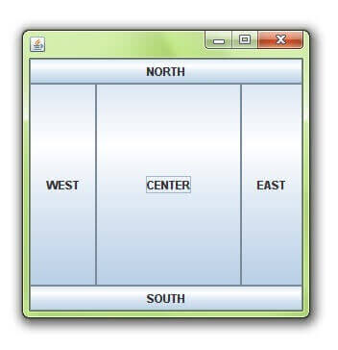
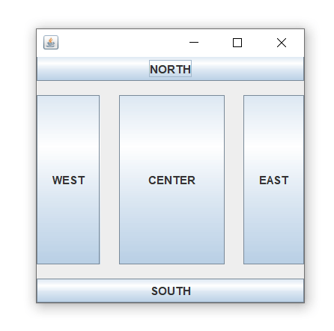
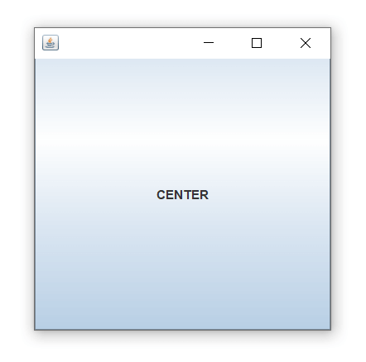

Slide 52
class Demo {
public static void main(String[] args) {
MyFrame f=new MyFrame();
} }

Slide 53
CardLayout
import java.awt.*;
class MyFrame extends Frame {
MyFrame() {
this.setSize(400,400);
this.setVisible(true);
this.setLayout(new CardLayout());
Button b1=new Button("button1");
Button b2=new Button("button2");
Button b3=new Button("button3");
Button b4=new Button("button4");
Button b5=new Button("button5");
this.add("First Card",b1);
this.add("Second Card",b2);
this.add("Thrid Card",b3);
this.add("Fourth Card",b4);
this.add("Fifth Card",b5); } }
class Demo {
public static void main(String args[]) {
MyFrame frame = new MyFrame();
}
}

Slide 54
GridLayout
class MyFrame extends Frame
{
MyFrame() {
this.setVisible(true);
this.setSize(500,500);
this.setTitle("rattaiah");
this.setBackground(Color.red);
this.setLayout(new GridLayout(4,4));
for (int i=0;i<10 ;i++ ){
Button b=new Button(""+i);
this.add(b);
}
}
}
class Demo {
public static void main(String[] args) {
MyFrame f=new MyFrame();
}
}

Slide 55
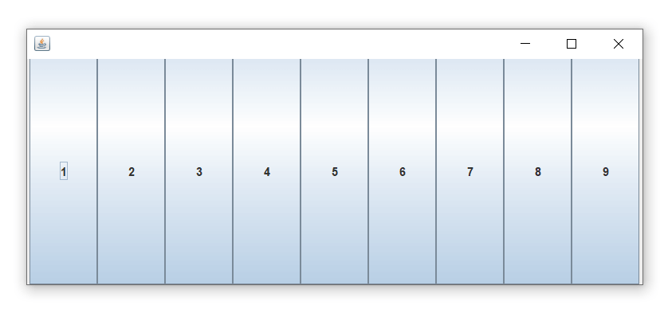
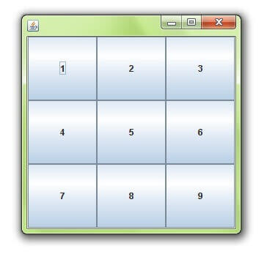
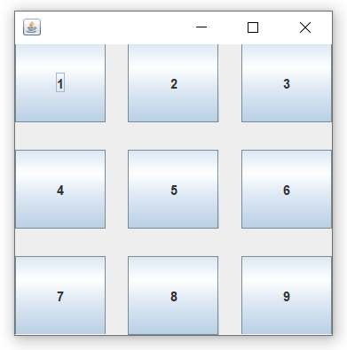

Slide 56
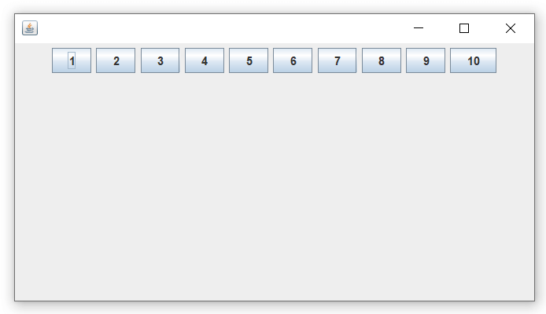
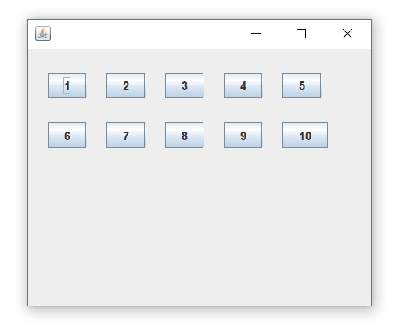
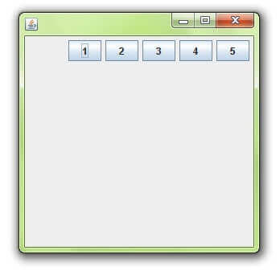

Slide 57
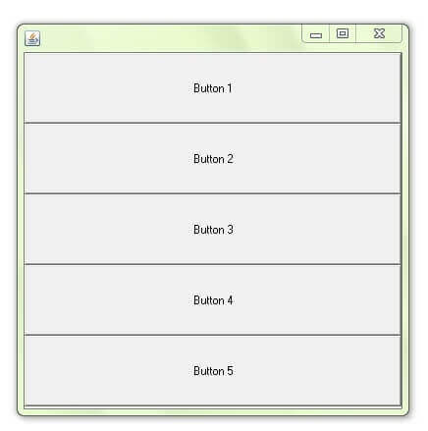
BoxLayout with X-AXIS

Slide 58
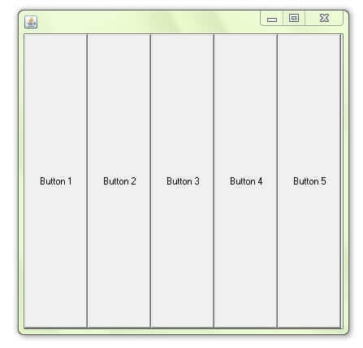
BoxLayout with LINE-AXIS

Slide 59
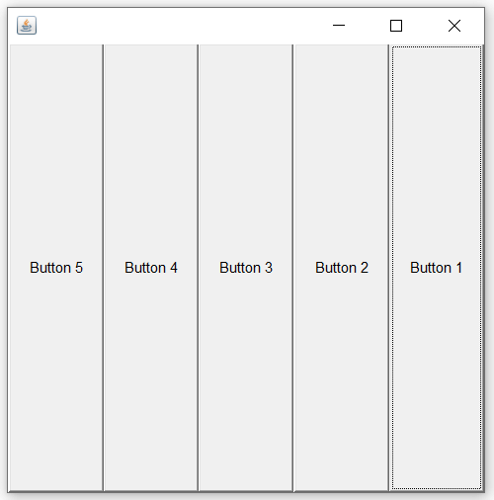
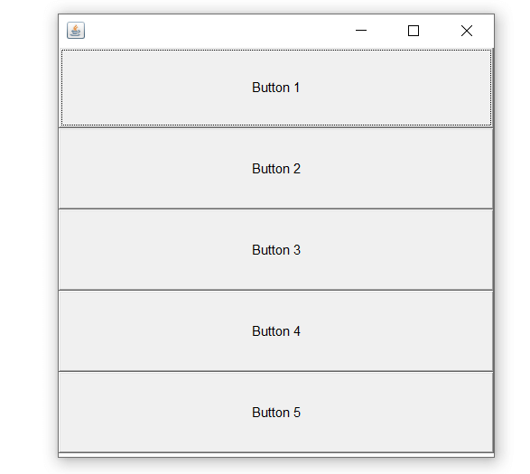
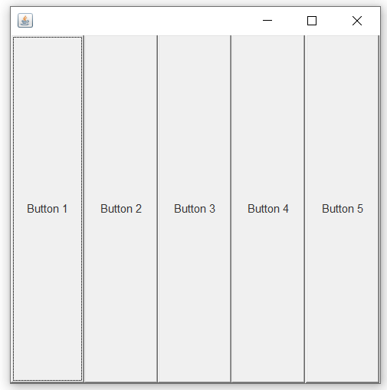
BoxLayout with PAGE-AXIS

Slide 60
Login Form
class MyFrame extends Frame implements ActionListener {
Label l1,l2; TextField tx1,tx2; Button b;
String status="";
MyFrame()
{
setVisible(true);
setSize(400,400);
setTitle("girls");
setBackground(Color.red);
l1=new Label("user name:");
l2=new Label("password:");
tx1=new TextField(25);
tx2=new TextField(25);
b=new Button("login");
b.addActionListener(this);
tx2.setEchoChar('*');
this.setLayout(new FlowLayout());
this.add(l1);
this.add(tx1);
this.add(l2);
this.add(tx2);
this.add(b);
}

Slide 61
Login Form
public void actionPerformed(ActionEvent ae) {
String uname=tx1.getText();
String upwd=tx2.getText();
if (uname.equals(”navbharti")&&upwd.equals(”aiitamity")) {
status="login success";
} else {
} repaint();
status="login failure";
}
public void paint(Graphics g)
{
Font f=new Font("arial",Font.BOLD,30);
g.setFont(f); this.setForeground(Color.green);
g.drawString("Status:----"+status,50,300);
}
}

Slide 62
MENUITEMS
import java.awt.*;
import java.awt.event.*;
class MyFrame extends Frame implements ActionListener {
String label="";
MenuBar mb;
Menu m1,m2,m3;
MenuItem mi1,mi2,mi3;
MyFrame()
{
this.setSize(300,300);
this.setVisible(true);
this.setTitle("myFrame");
this.setBackground(Color.green);
mb=new MenuBar();
this.setMenuBar(mb);
m1=new Menu("new");
m2=new Menu("option");
m3=new Menu("edit");
mb.add(m1); mb.add(m2);
mb.add(m3);

Slide 63
MENUITEMS
mi1=new MenuItem("open");
mi2=new MenuItem("save");
mi3=new MenuItem("saveas");
mi1.addActionListener(this);
mi2.addActionListener(this);
mi3.addActionListener(this);
m1.add(mi1); m1.add(mi2);
repaint(); }
public void mouseReleased(MouseEvent e) {
msg[2]="mouse released......("+e.getX()+","+e.getY()+")";
repaint(); }
public void mouseEntered(MouseEvent e) {
msg[3]="mouse entered......("+e.getX()+","+e.getY()+")";
repaint(); }
public void mouseExited(MouseEvent e) {
msg[4]="mouse exited......("+e.getX()+","+e.getY()+")";
repaint(); }

Slide 64
MENUITEMS
public void paint(Graphics g) {
int X=50;
int Y=100;
for(int i=0;i<msg.length;i++) {
if (msg[i]!=null) {
g.drawString(msg[i],X,Y);
Y=Y+50; }
}
}
}
class Demo {
public static void main(String[] args) {
MyFrame f=new MyFrame();
}
}

Slide 65
MENUITEMS
import java.awt.*;
import java.awt.event.*;
class MyFrame extends Frame implements ActionListener {
String label="";
MenuBar mb;
Menu m1,m2,m3;
MenuItem mi1,mi2,mi3;
MyFrame()
{
this.setSize(300,300);
this.setVisible(true);
this.setTitle("myFrame");
this.setBackground(Color.green);
mb=new MenuBar();
this.setMenuBar(mb);
m1=new Menu("new");
m2=new Menu("option");
m3=new Menu("edit");
mb.add(m1); mb.add(m2);
mb.add(m3);
mi1=new MenuItem("open");
mi2=new MenuItem("save");
mi3=new MenuItem("saveas");
mi1.addActionListener(this);
mi2.addActionListener(this);
mi3.addActionListener(this);
m1.add(mi1); m1.add(mi2);
repaint();
}
public void mouseReleased(MouseEvent e) {
msg[2]="mouse released......("+e.getX()+","+e.getY()+")";
repaint(); }
public void mouseEntered(MouseEvent e) {
msg[3]="mouse entered......("+e.getX()+","+e.getY()+")";
repaint(); }
public void mouseExited(MouseEvent e) {
msg[4]="mouse exited......("+e.getX()+","+e.getY()+")";
repaint(); }
public void paint(Graphics g) {
int X=50;
int Y=100;
for(int i=0;i<msg.length;i++) {
if (msg[i]!=null) {
g.drawString(msg[i],X,Y);
Y=Y+50; }
}
}
}
class Demo {
public static void main(String[] args) {
MyFrame f=new MyFrame();
}
}

Slide 66
Event handling
It is possible to write the event handling code in fallowing ways
In different class.
Same class
By using anonymous inner classes.
Steps to perform event handling:-
1) Prepare the required components.
2) Implements the listener interface override the methods to write the even handling code.
3) Add the listener to the component.

Slide 67
Applying WindowListener on the Frame
The Frame contains WindowLister it contains 7-methods listed below.
windowActivated(WindowEvent e) Invoked when the Window is set to be the active Window.
windowClosed(WindowEvent e) Invoked when a window has been closed as the result of calling dispose on the window.
windowClosing(WindowEvent e) Invoked when the user attempts to close the window from the window's system menu.
windowDeactivated(WindowEvent e) Invoked when a Window is no longer the active Window.
windowDeiconified(WindowEvent e) Invoked when a window is changed from a minimized to a normal state.
windowIconified(WindowEvent e) Invoked when a window is changed from a normal to a minimized state.
windowOpened(WindowEvent e) Invoked the first time a window is made visible.

Slide 68
Note : if our class implements WindowListener interface we must override all the methods of windowListener interface . But if our class extends windowAdaptor class it is possible to override application required methods. class MyFrame extends Frame { MyFrame()
{ this.setVisible(true); this.setSize(500,500);
this.setBackground(Color.red); this.setTitle("MyFrame"); this.addWindowListener(new Listenerimpl());
} };
class Listenerimpl extends WindowAdapter { public void windowClosing(WindowEvent we)
{ System.exit(0);
} };
class Demo { public static void main(String[] args)
{ MyFrame f=new MyFrame();
} };

Slide 69
event handling in anonymous inner class
import java.awt.*; import java.awt.event.*; class MyFrame extends Frame { MyFrame()
{ this.setVisible(true);
this.setSize(500,500);
} }
this.setBackground(Color.red);
this.setTitle("Myframe");
this.addWindowListener(new WindowAdapter() { public void windowClosing(WindowEvent we)
{ System.exit(0);
} });
class Demo { public static void main(String[] args)
{ MyFrame f=new MyFrame();
} };

Slide 70
ACTIONLISTENER
The below example we are preforming addition and multiplications when we click add & mul buttons. So whenever we clicking button the button is able to listen the even to do this add the Listener to button. The appropriate listener for button is ActionListener.

Slide 71
public void actionPerformed(ActionEvent e) {
try{
int fval=Integer.parseInt(tx1.getText());
int sval=Integer.parseInt(tx2.getText());
String label=e.getActionCommand(); if (label.equals("add"))
{ result=fval+sval; } if (label.equals("mul")) { result=fval*sval; }
tx3.setText(""+result); } catch(Exception ee) { ee.printStackTrace(); }

Slide 72
Login Form
class MyFrame extends Frame implements ActionListener {
Label l1,l2;
TextField tx1,tx2; Button b;
String status="";
MyFrame(){
setVisible(true);
setSize(400,400);
setTitle("girls");
setBackground(Color.red);
l1=new Label("user name:");
l2=new Label("password:");
tx1=new TextField(25);
tx2=new TextField(25);
b=new Button("login");
b.addActionListener(this);
tx2.setEchoChar('*');
this.setLayout(new FlowLayout());
this.add(l1);
this.add(tx1);
this.add(l2);
this.add(tx2);
this.add(b);
}
public void actionPerformed(ActionEvent ae) {
String uname=tx1.getText();
String upwd=tx2.getText();
if (uname.equals("Sravya")&&upwd.equals("dss")){
status="login success";
} else {
status="login failure";
}
repaint();
}
public void paint(Graphics g)
{
Font f=new Font("arial",Font.BOLD,30);
g.setFont(f);
this.setForeground(Color.green);
g.drawString("Status:----"+status,50,300);
}
}
class Demo
{ public static void main(String[] args)
{ MyFrame f=new MyFrame();
} }

Slide 73
Login Form
this.add(tx2);
this.add(b);
}
public void actionPerformed(ActionEvent ae) {
String uname=tx1.getText();
String upwd=tx2.getText();
if (uname.equals("Sravya")&&upwd.equals("dss")){
status="login success";
} else {
status="login failure";
}
repaint();
}
public void paint(Graphics g)
{
Font f=new Font("arial",Font.BOLD,30);
g.setFont(f);
this.setForeground(Color.green);
g.drawString("Status:----"+status,50,300);
}
}
class Demo
{ public static void main(String[] args)
{ MyFrame f=new MyFrame();
} }

Slide 74
Login Form
class Demo
{ public static void main(String[] args)
{ MyFrame f=new MyFrame();
} }

Slide 75
MenuItem
class MyFrame extends Frame implements ActionListener {
String label="";
MenuBar mb;
Menu m1,m2,m3;
MenuItem mi1,mi2,mi3;
MyFrame()
{ this.setSize(300,300);
this.setVisible(true);
this.setTitle("myFrame");
this.setBackground(Color.green);
mb=new MenuBar();
this.setMenuBar(mb);
m1=new Menu("new");
m2=new Menu("option");
m3=new Menu("edit");
mb.add(m1);
mb.add(m2);
mb.add(m3);
mi1=new MenuItem("open");
mi2=new MenuItem("save");
mi3=new MenuItem("saveas");
mi1.addActionListener(this);
mi2.addActionListener(this);
mi3.addActionListener(this);
m1.add(mi1);
m1.add(mi2);
m1.add(mi3);
}
public void actionPerformed(ActionEvent ae) {
label=ae.getActionCommand();
repaint();
}
public void paint(Graphics g) {
Font f=new Font("arial",Font.BOLD,25);
g.setFont(f);
g.drawString("Selected item....."+label,50,200);
}
}
class Demo{
public static void main(String[] args) {
MyFrame f=new MyFrame();
}
}

Slide 76
MenuItem
mi3=new MenuItem("saveas");
mi1.addActionListener(this);
mi2.addActionListener(this);
mi3.addActionListener(this);
m1.add(mi1);
m1.add(mi2);
m1.add(mi3);
}
public void actionPerformed(ActionEvent ae) {
label=ae.getActionCommand();
repaint();
}
public void paint(Graphics g) {
Font f=new Font("arial",Font.BOLD,25);
g.setFont(f);
g.drawString("Selected item....."+label,50,200);
}
}
class Demo{
public static void main(String[] args) {
MyFrame f=new MyFrame();
}
}

Slide 77
MouseListener
class myframe extends Frame implements MouseListener {
String[] msg=new String[5];
myframe()
{ this.setSize(500,500);
this.setVisible(true);
this.addMouseListener(this);
}
public void mouseClicked(MouseEvent e)
{ msg[0]="mouse clicked......("+e.getX()+","+e.getY()+")";
repaint(); }
public void mousePressed(MouseEvent e)
{ msg[1]="mouse pressed......("+e.getX()+","+e.getY()+")";
repaint(); }
public void mouseReleased(MouseEvent e)
{ msg[2]="mouse released......("+e.getX()+","+e.getY()+")";
repaint(); }
public void mouseEntered(MouseEvent e)
{ msg[3]="mouse entered......("+e.getX()+","+e.getY()+")";
repaint(); }
public void mouseExited(MouseEvent e)
{ msg[4]="mouse exited......("+e.getX()+","+e.getY()+")";
repaint(); }
public void paint(Graphics g) { int X=50;
int Y=100;
for(int i=0;i<msg.length;i++) {
if (msg[i]!=null)
{ g.drawString(msg[i],X,Y); Y=Y+50;
}
}
}
}
class Demo
{ public static void main(String[] args)
{ myframe f=new myframe();
} }

Slide 78
MouseListener
{ msg[3]="mouse entered......("+e.getX()+","+e.getY()+")";
repaint(); }
public void mouseExited(MouseEvent e)
{ msg[4]="mouse exited......("+e.getX()+","+e.getY()+")";
repaint(); }
public void paint(Graphics g) { int X=50;
int Y=100;
for(int i=0;i<msg.length;i++) {
if (msg[i]!=null)
{ g.drawString(msg[i],X,Y); Y=Y+50;
}
}}}
class Demo
{ public static void main(String[] args)
{ myframe f=new myframe();
} }

Slide 79
ItemListener
import java.awt.*;
import java.awt.event.*;
class myframe extends Frame implements ItemListener {
String qual="",gen="";
Label l1,l2;
CheckboxGroup cg;
Checkbox c1,c2,c3,c4,c5;
Font f;
myframe()
{ this.setSize(300,400);
this.setVisible(true);
this.setLayout(new FlowLayout());
l1=new Label("Qualification: ");
l2=new Label("Gender: ");
c1=new Checkbox("BSC");
c2=new Checkbox("BTECH");
c3=new Checkbox("MCA");
cg=new CheckboxGroup();
c4=new Checkbox("Male",cg,false);
c5=new Checkbox("Female",cg,true);
c1.addItemListener(this);
c2.addItemListener(this);
c3.addItemListener(this);
c4.addItemListener(this);
c5.addItemListener(this);
this.add(l1); this.add(c3); this.add(c5);
this.add(c1); this.add(l2);
this.add(c2); this.add(c4);
public void itemStateChanged(ItemEvent ie) {
if(c1.getState()==true)
{ qual=qual+c1.getLabel()+","; }
if(c2.getState()==true)
{ qual=qual+c2.getLabel()+","; }
if(c3.getState()==true)
{ qual=qual+c3.getLabel()+","; }
if(c4.getState()==true)
{ gen=c4.getLabel();}
if(c5.getState()==true)
{ gen=c5.getLabel(); }
repaint();
}
public void paint(Graphics g)
{ Font f=new Font("arial",Font.BOLD,20);
g.setFont(f);
this.setForeground(Color.green);
g.drawString("qualification------>"+qual,50,100);
g.drawString("gender-------------->"+gen,50,150);
qual="";
gen="";
}
}
class ItemListenerDemo
{ public static void main(String[] args)
{ myframe f=new myframe();
} }

Slide 80
ItemListener
c1.addItemListener(this);
c2.addItemListener(this);
c3.addItemListener(this);
c4.addItemListener(this);
c5.addItemListener(this);
this.add(l1); this.add(c3); this.add(c5);
this.add(c1); this.add(l2);
this.add(c2); this.add(c4);
public void itemStateChanged(ItemEvent ie) {
if(c1.getState()==true)
{ qual=qual+c1.getLabel()+","; }
if(c2.getState()==true)
{ qual=qual+c2.getLabel()+","; }
if(c3.getState()==true)
{ qual=qual+c3.getLabel()+","; }
if(c4.getState()==true)
{ gen=c4.getLabel();}
if(c5.getState()==true)
{ gen=c5.getLabel(); }
repaint();
}
public void paint(Graphics g)
{ Font f=new Font("arial",Font.BOLD,20);
g.setFont(f);
this.setForeground(Color.green);
g.drawString("qualification------>"+qual,50,100);
g.drawString("gender-------------->"+gen,50,150);
qual="";
gen="";
}
}
class ItemListenerDemo
{ public static void main(String[] args)
{ myframe f=new myframe();
} }

Slide 81
ItemListener
public void paint(Graphics g)
{ Font f=new Font("arial",Font.BOLD,20);
g.setFont(f);
this.setForeground(Color.green);
g.drawString("qualification------>"+qual,50,100);
g.drawString("gender-------------->"+gen,50,150);
qual="";
gen="";
}
}
class ItemListenerDemo
{ public static void main(String[] args)
{ myframe f=new myframe();
} }

Slide 82
KeyboardListener
class myframe extends Frame
{
myframe()
{ this.setSize(400,400);
this.setVisible(true);
this.setBackground(Color.green);
this.addKeyListener(new keyboardimpl());
}
}
class keyboardimpl implements KeyListener {
public void keyTyped(KeyEvent e){
System.out.println("key typed "+e.getKeyChar());
}
public void keyPressed(KeyEvent e){
System.out.println("key pressed "+e.getKeyChar());
}
public void keyReleased(KeyEvent e){
System.out.println("key released "+e.getKeyChar());
}
}
class Demo
{ public static void main(String[] args)
{ myframe f=new myframe();
} }

Slide 83
Swings
Sun Micro Systems introduced AWT to prepare GUI applications but awt components not satisfy the client requirement.
An alternative to AWT Netscape Communication Corporation has provided set of GUI components in the form of IFC(Internet Foundation Class) but IFC also provide less performance and it is not satisfy the client requirement.
In the above context[sun & Netscape] combine and introduced common product to design GUI applications is called JFS(java foundation classes) then it is renamed as swings.

Slide 84
AWT vs Swings
AWT components are platform dependent but Swings components are platform independent because these components are completely written in java .
AWT components are heavyweight component but swing components are light weight component.
AWT components consume more number of system resources Swings consume less number of system resources.
AWT is provided less number of components whereas a swing provides more number of components.
AWT doesn’t provide Tooltip Test support but swing components have provided Tooltip test support.
In awt to close the window : windowListener windowAdaptor In case of swing use small piece of code. f.setDefaultCloseOption(JFrame.EXIT-ON-CLOSE);
In case of AWT we will add the GUI components in the Frame directly but Swing we will add all GUI components to panes to accommodate GUI components.
The awt classes & interfaces are present in java.awt packages & swing classes are present in javax.swing package.

Slide 85
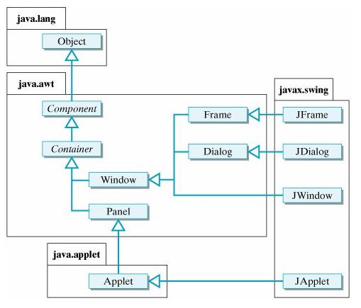

Slide 86
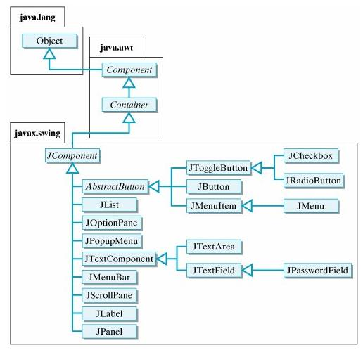

Slide 87
JFrame Demo
public class MyFrame extends JFrame{
public MyFrame() {
setVisible(true);
setSize(300, 300);
setTitle("MyFrame");
setDefaultCloseOperation(JFrame.EXIT_ON_CLOSE);
setLayout(new FlowLayout());
JLabel label = new JLabel("Hello World:");
JButton button = new JButton("click me");
add(label);
add(button);
}
public static void main(String[] args) {
MyFrame f = new MyFrame();
}
}

Slide 88
SWING GUI COMPONENTS EXAMPLE
class JFrame1Demo extends JFrame{
JLabel l1,l2,l3,l4,l5,l6,l7;
JTextField tf;
JPasswordField pf;
JCheckBox cb1,cb2,cb3;
JRadioButton rb1,rb2;
JList l;
JComboBox cb;
JTextArea ta;
JButton b;
Container c;
JFrame1Demo()
{
setVisible(true);
setSize(150,500);
setTitle("SWING GUI COMPONENTS EXAMPLE");
setDefaultCloseOperation(JFrame.EXIT_ON_CLOSE);
setLayout(new FlowLayout());
getContentPane().setBackground(Color.red);
setBackground(Color.green);

Slide 89
l1=new JLabel("User Name");
l2= new JLabel("password");
l3= new JLabel("Qualification");
l4= new JLabel("User Gender");
l5= new JLabel("Technologies");
l6= new JLabel("UserAddress");
l7= new JLabel("comments");
tf=new JTextField(15);
tf.setToolTipText("TextField");
pf=new JPasswordField(15);
pf.setToolTipText("PasswordField");
cb1=new JCheckBox("BSC",false);
cb2=new JCheckBox("MCA",false);
cb3=new JCheckBox("PHD",false);
rb1=new JRadioButton("Male",false);
rb2=new JRadioButton("Female",false);
ButtonGroup bg=new ButtonGroup();
bg.add(rb1);

Slide 90
bg.add(rb2);
String[] listitems={"cpp","c","java"};
l=new JList(listitems);
String[] cbitems={"hyd","pune","bangalore"};
cb=new JComboBox(cbitems);
ta=new JTextArea(5,20);
b=new JButton("submit");
add(l1);
add(tf);
add(l3);
add(l4);
add(l);
add(ta);
add(l2);

Slide 91
add(pf);
add(cb1);
add(cb2);
add(cb3);
add(rb1);
add(rb2);
add(l5);
add(l6);
add(cb);
add(l7);
add(b);
}
public static void main(String[] args) {
JFrame1Demo f=new JFrame1Demo();
}
}

Slide 92
ImageIcon in Swings
public class MyFrame extends JFrame{
public MyFrame() {
setVisible(true);
setSize(200, 200);
setTitle("MyFrame");
setDefaultCloseOperation(JFrame.EXIT_ON_CLOSE);
setLayout(new BorderLayout()); //setting layout to frame
JLabel label = new JLabel(new ImageIcon("download.jpg"));
add(label);
label.setLayout(new FlowLayout()); // setting layout to back ground image
JLabel label2 = new JLabel("Hello World:");
JButton button = new JButton("click me");
label.add(label2);
label.add(button);
}
public static void main(String[] args) {
MyFrame f = new MyFrame();
}
}

Slide 93
MessageDialog in Swings
public class MyFrame2 extends JFrame implements ActionListener {
JRadioButton button1,button2;
JButton button;
public MyFrame2() {
setVisible(true);
setTitle("MyFrame");
setSize(300, 300);
setLayout(new FlowLayout());
button1 = new JRadioButton("Male");
button2 = new JRadioButton("Female");
button = new JButton("click");
ButtonGroup group = new ButtonGroup();
group.add( button1);
group.add( button2);
add(button1);
add(button2);
add(button);
button.addActionListener(this);
}

Slide 94
MessageDialog in Swings
@Override
public void actionPerformed(ActionEvent e) {
if(button1.isSelected())
{ JOptionPane.showMessageDialog(this, "U r selected Male option thankyou");}
if(button2.isSelected())
{ JOptionPane.showMessageDialog(this, "U r selected Female option thankyou");}
}
public static void main(String[] args) {
MyFrame2 frame2 = new MyFrame2();
}
}

Slide 95
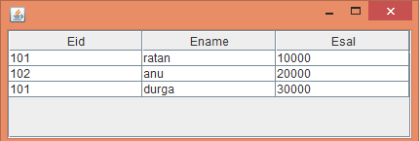
JTable Demo
public class JFrame4Demo extends JFrame {
public JFrame4Demo() {
setVisible(true);
setSize(400, 200);
setDefaultCloseOperation(JFrame.EXIT_ON_CLOSE);
String[][] data={{"101",”rakesh","10000"},{"102",”Sita","20000"},{"101",”Rajeev","30000"}};
String[] col={"Eid","Ename","Esal"};
JTable jTable = new JTable(data,col);
add(jTable);
JScrollPane jScrollPane = new JScrollPane(jTable); add(jScrollPane);
}
public static void main(String[] args)
{
JFrame4Demo frame3 = new JFrame4Demo();
}
}

Slide 96
JColorChooser
class JFrame5 extends JFrame implements ChangeListener { JColorChooser cc;
Container c;
JFrame5(){
this.setVisible(true);
this.setSize(500,500);
this.setTitle("SWING COLORCHOOSER EXAMPLE");
this.setDefaultCloseOperation(JFrame.EXIT_ON_CLOSE);
c=getContentPane();
cc=new JColorChooser();
cc.getSelectionModel().addChangeListener(this);
c.add(cc);
}
public void stateChanged(ChangeEvent c) {
Color color=cc.getColor();
JFrame f=new JFrame();
f.setSize(400,400);
f.setVisible(true);
f.getContentPane().setBackground(color);
}
}

Slide 97
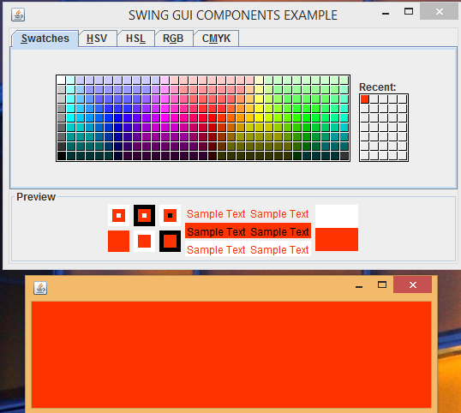
JColorChooser
public class ColorChooserDemo{
public static void main(String[] args)
{
JFrame5 f=new JFrame5();
}
}

Slide 98
JFileChooser
public class JFileChooserDemo {
public static void main(String[] args){
JFrame6 f=new JFrame6();
} }
class JFrame6 extends JFrame implements ActionListener{
JFileChooser fc;
Container c;
JLabel l;
JTextField tf;
JButton b;
JFrame6(){
this.setVisible(true);
this.setSize(500,500);
this.setTitle("SWING GUI COMPONENTS EXAMPLE");
this.setDefaultCloseOperation(JFrame.EXIT_ON_CLOSE);
c=getContentPane();
l=new JLabel("Select File:");
tf=new JTextField(25);
b=new JButton("BROWSE");
this.setLayout(new FlowLayout());
b.addActionListener(this);
c.add(l);
c.add(tf);
c.add(b);
}

Slide 99
JFileChooser
public void actionPerformed(ActionEvent ae)
{
class FileChooser1 extends JFrame implements ActionListener
{
FileChooser1()
{
Container c=getContentPane();
this.setVisible(true); this.setSize(500,500);
fc=new JFileChooser(); fc.addActionListener(this); fc.setLayout(new FlowLayout()); c.add(fc);
}
public void actionPerformed(ActionEvent ae) {
File f=fc.getSelectedFile();
String path=f.getAbsolutePath();
tf.setText(path);
this.setVisible(false);
}
}
new FileChooser1();
}
}

Slide 100
THANK
YOU

